Slide 1


May 4, 2026

Slide 2
ASHRAE VALUE STATEMENT:
“In ASHRAE meetings, we will act with honesty, fairness, courtesy, competence, inclusiveness and respect for others, which exemplify our core values of excellence, commitment, integrity, collaboration, volunteerism and diversity, and shall avoid all real or perceived conflicts of interest. Our culture is one of inclusiveness, acknowledging the inherent value and dignity of each individual. We celebrate diverse and inclusive communities, understanding that doing so fuels better, more creative and more thoughtful ideas, solutions and strategies for the Society and the communities our Society serves. We respect and welcome all.”
ASHRAE DIVERSITY STATEMENT:
ASHRAE is committed to providing a welcoming environment. Our culture is one of inclusiveness, acknowledging the inherent value and dignity of each individual. We proactively pursue and celebrate diverse and inclusive communities understanding that doing so fuels better, more creative and more thoughtful ideas, solutions and strategies for the Society and for the communities our Society serves. We respect and welcome all people regardless of age, gender, ethnicity, physical appearance, thought styles, religion, nationality, socio-economic status, belief systems, sexual orientation or education.

Slide 3



Slide 4

Thank you to our Donors who contributed to our 2025-2026 Product Directory.
Thank you to our other Corporate and Individual Donors.
The donations made during our Research Promotion campaign fund research into emerging technologies and development of standards that are vital to our industries and we thank all donors for their support and generosity. To donate to our Research Promotion Campaign reach out to Alan Sparling or another Board Member for more information.

Slide 5
Major Donor - Silver ($1,000-$2,499):
Barbara Hayter (Dr. Richard Hayter Foundation)
SystemAir
Associated Equipment Sales

Slide 6
Major Donor – Bronze ($500-$999):
SMACNA KC

Slide 7
Major Donor - Antique ($250-$499):
Andrea Phillips
Jonathan Smith
Ralph Metcalf

Slide 8
Honor Roll ($150-$249):
Alan Sparling
Kelly Cramm
Stuart Braden
Mark Snyder
Full Circle ($100):
Ian Kobler
Dan Moresi
Jennifer Nelson
Scott McVey

Slide 9
Upcoming Meetings
It’s Summer Break! Consider joining us at CRC in Omaha in July!
Watch your inboxes in August for the September Meeting.
We are brining Rick Bock in from the cancelled December meeting. He will be presenting on the basics of steam system design.

Slide 10
Upcoming Events:
50th Annual Golf Tournament:
May 15, 2026
St Andrew’s Golf Club – Overland Park
Team Registrations and Sponsorships are still available! See the website for sign up information.

Slide 11
Sustainability Update
We will continue recycling the past Product Directories at monthly meetings all year next year.
Please bring any older Product Directories (without the spiral binding) that you would like to recycle to assist us in this effort!

Slide 12
Government Affairs Update
We had delegations of advocates go to both the Kansas and Missouri Legislatures for Day on the Hill events this year. Thank you to all who attended these events!
They were both well attended by the GAC committee and included Jonathan Smith, DRC Region IX who attended the MO event. MO is presently evaluating legislation that will roll back energy code adoptions throughout the state and limit the ability of local jurisdictions to require a newer or more stringent code. ASHRAE is watching this unfold and advocating against the proposed legislation.

Slide 13


Slide 14
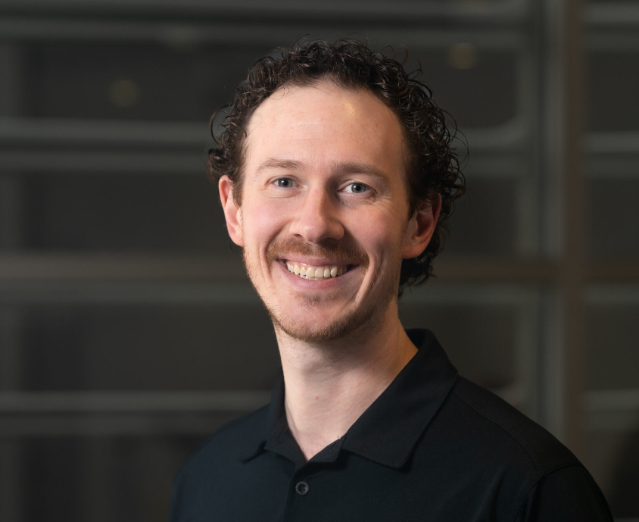
Room Pressurization Solutions for Critical Spaces
Presented by : Curtis Carrick
Curtis Carrick is part of the Technical Sales team at Antec Controls by Price. He holds a Masters in Mechanical Engineering (2012) and has been with Price Industries for over 13 years – the last 6 years with Antec Controls. His technical background is focused on valve technology and controls applied within critical spaces, though he is also very passionate about valve acoustics.

